Slide 1
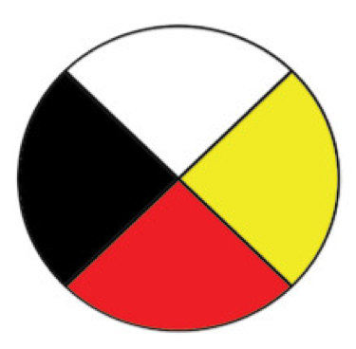
How One Person Can Make A Difference
If You Plant It, It Will Grow
Agopian, M., Auger, C., Beddie, K., Leighton, E., and Taylor, P.
Werklund School of Education
Rationale
Unit Plan & Learning Outcomes
Technology and Ways of Knowing
This Grade 6 Interdisciplinary Unit Plan incorporates English Language Arts, Science, Physical Education, Health and Wellness, Art, Technology, and Social Studies to cover the important focus of taking responsibility of our individual actions to sustain life on Earth. By planting these seeds of knowledge in Grade 6 students the goal is to create more environmentally aware citizens.
Unit Plan:
I take responsibility for myself and my actions to sustain life on Earth.
Week One:
How can we take responsibility for ourselves and relationship with nature?
Poetry, Medicine Wheel, and Nature Walk.
Week Two:
How can we live more responsibly in our classroom community and at home?
Poetry, newspaper article, trees and forests introduction, ecosystems, and Weaselhead field trip.
Week Three:
What can we do as communities to encourage our municipalities to plant trees that are conducive to our environment?
Business letter, Trees and Forests in relation to community, and Jumping pound field trip.
Week Four:
On a global level (National/International), in what ways can we contribute to living more sustainably and responsibly on Earth?
Debate, legislation, and The Lorax.
Week Five:
How can one person make a difference?
Working periods, finalizing showcase, presentations and sharing.
Learning Outcomes:
Grade Six English Language Arts: 1.1, 1.2, 2.2, 2.3, 2.4, 3.1, 3.2, 3.3, 3.4, 4.1, 4.2, 4.3, 5.1, 5.2.
Grade Six Social Studies: 6.1, 6.1.1, 6.1.2, 6.1.3, 6.1.5, 6.1.6, 6.S.5, 6.S.6, 6.S,8
Grade 6 Health & Wellness: W-6.1, R-6.1, R-6.3, L-6.3
Grade 6 Science: 6.2, 6.3, 6.4, 6.10
Technology: Our unit plan utilizes technology to access information from current resources including digital media, websites and videos on YouTube so students can tap into real-world knowledge from experts regarding current environmental and political issues, thus, situating students in the best spot to deepen understandings and develop critical thinking and capacity to solve 21st century problems.
The Medicine Wheel is a traditional Indigenous way of knowing that represents the alignment and continuous interaction of the physical, emotional, mental, and spiritual realities. The circle shape represents the interconnectivity of all aspects of one's being, including the connection with the natural world. As is teaching, everything is connected. Using the Medicine Wheel as a framework to shift our learning lens to a holistic view of our students enables us to transmit knowledge through a balanced emphasis on all aspects of the student; mental, physical, spiritual, and emotional.
Interdisciplinarity and Differentiation
Our unit includes many differentiation strategies for English Language Learners or students with learning challenges: Completion of written assignments as multimodal texts, including short videos, posters, or diagrams, use of speech to text software, completion of assignments in home language.
Translation software may be used to produce a text for sharing or assessment. Group activities afford endless possibilities for differentiation, and students may choose roles and tasks that capitalize on their strengths.
Assessment Overview
Our assessment will allow us to see student growth in a variety of areas including; Understanding personal experiences, story-telling, sharing perspectives, creative thinking, originality, being open to new ideas, perception, critical thinking, brainstorming, freestyle writing, illustrations, sharing passion/feelings, expression, freedom of speech, healing through writing, and imagination.
By using formative assessments throughout the duration of the unit, we will be able to discern if students are absorbing the content. Also, when noticing gaps, the ability to change the assessment based on that formative knowledge collected throughout the unit will allow for a more comprehensive, valid, and reliable assessment.
Artefacts
Click the icon to listen
Activity 1
Medicine Wheel
Activity 2
Poem
Activity 3
Question Period Debate

